Slide 1
Summit Navigator: A Novel Approach for local Maxima Extraction
Presented By-
Saurabh Chatterjee(22EE65R14)
Abhijeet Aditya(22EE65R16)
Chandrashekhar Maurya(22EE65R13)

Slide 2

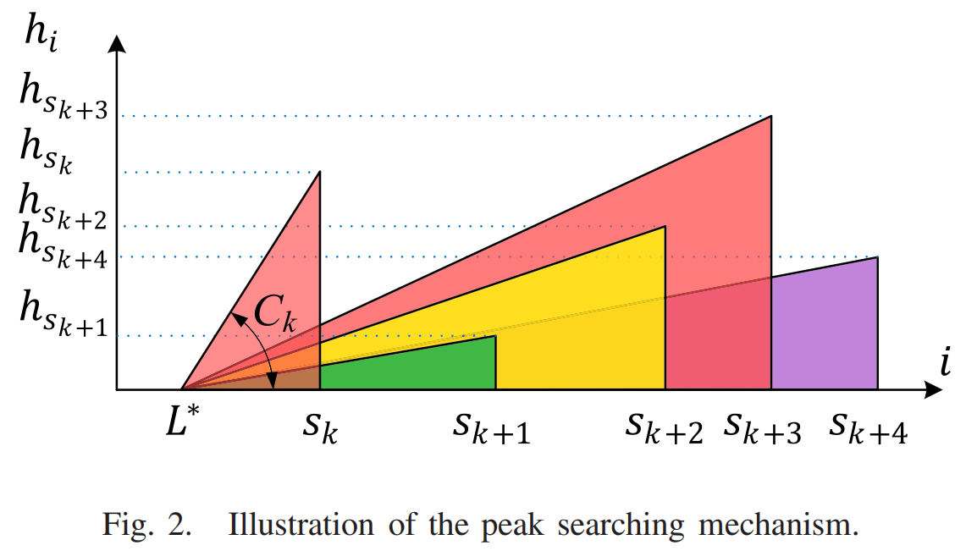
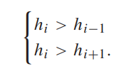


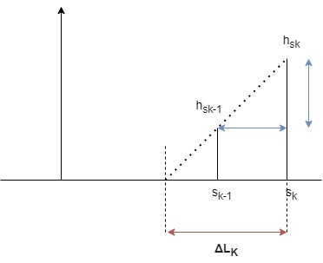

Methodology
Moving Average:
Initial Peak detection: Select the points satisfying condition
Peak Searching:
Initial observing pt.
where
Observability index:
In this we find an observable location from where it can measure heights of all
peaks in linear way.

Slide 3
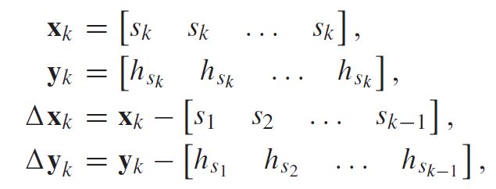
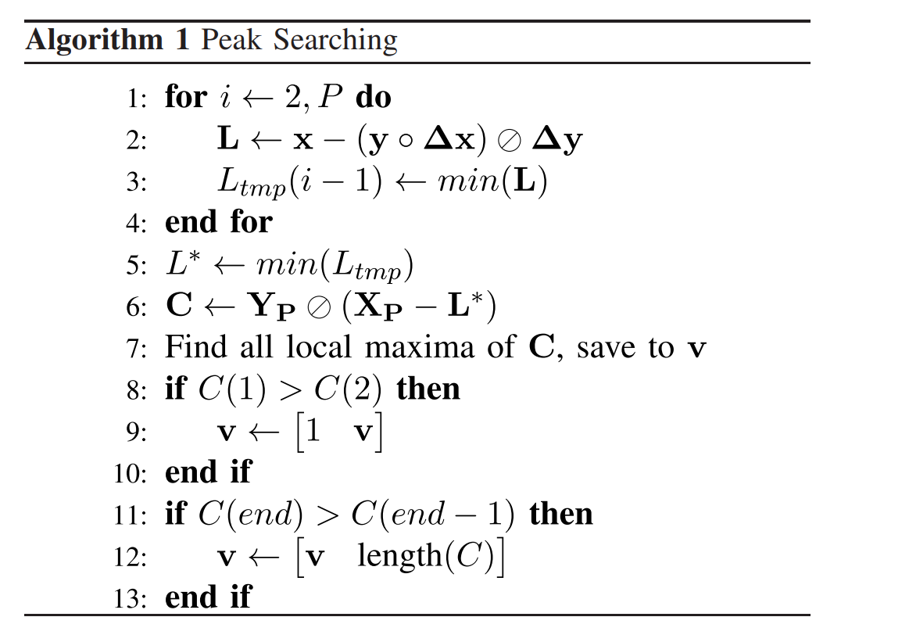



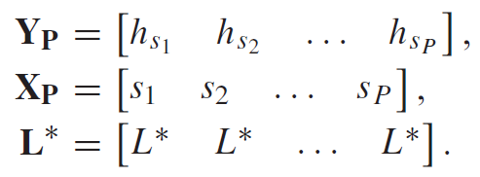
Set of observing locations for each initial peak:
Best observing location:
Observability indices for each initial peak:
where

Slide 4
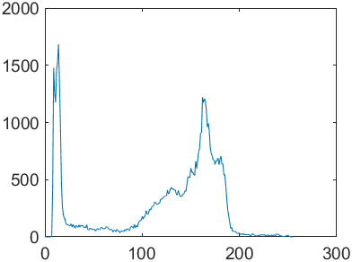
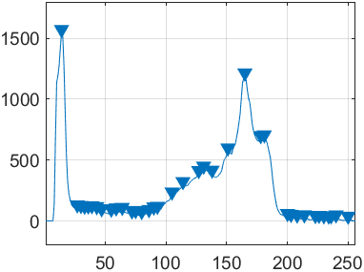
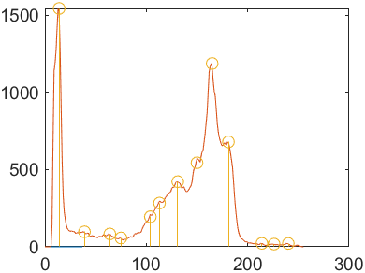
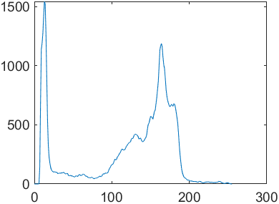
THANK YOU

